Slide 1
Operating Systems
Dr. Deepak Dembla

Slide 2
File System Implementation

Slide 3
Objectives
Layered Structure for File System
On-disk file system implementation data structures
In-memory file system implementation data structures
File mapping on disk
Implementation of file related operations
File allocation methods: Contiguous, Linked, Indexed
Free space management
Directory implementation
Backup and recovery methods for file system
File inconsistencies and the checks against them
File System performance issues
Log structured file system

Slide 4
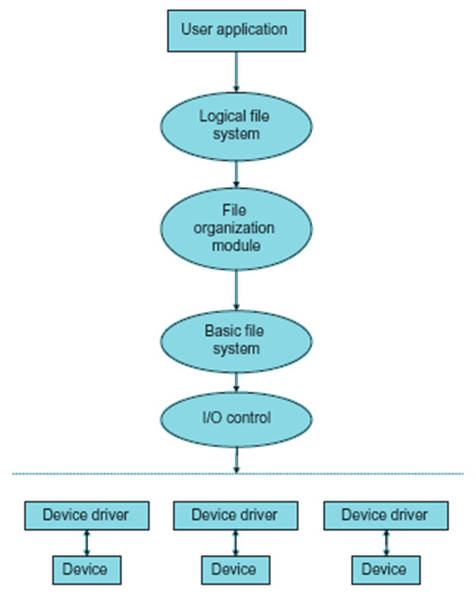
File system structure
Layered structure of the file system

Slide 5
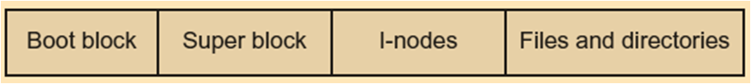
Implementation data structures
Disk layout implementing the file system

Slide 6
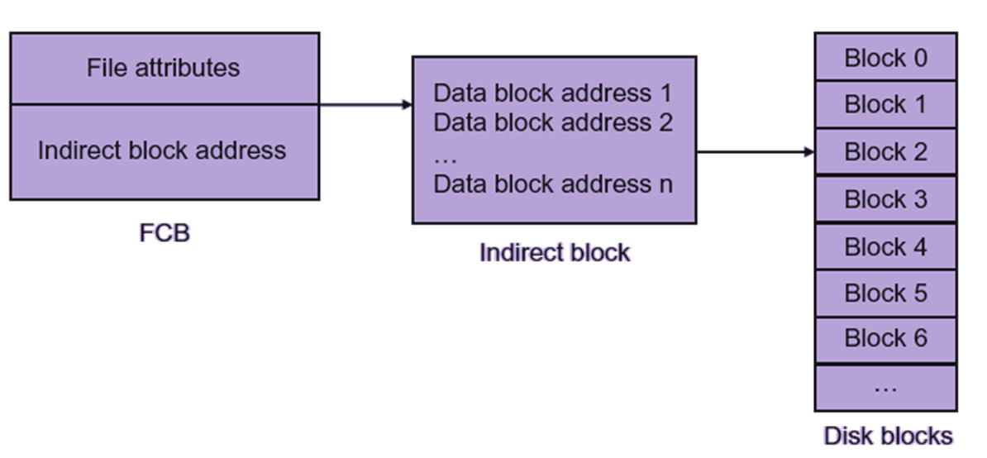
File mapping through indirect block

Slide 7
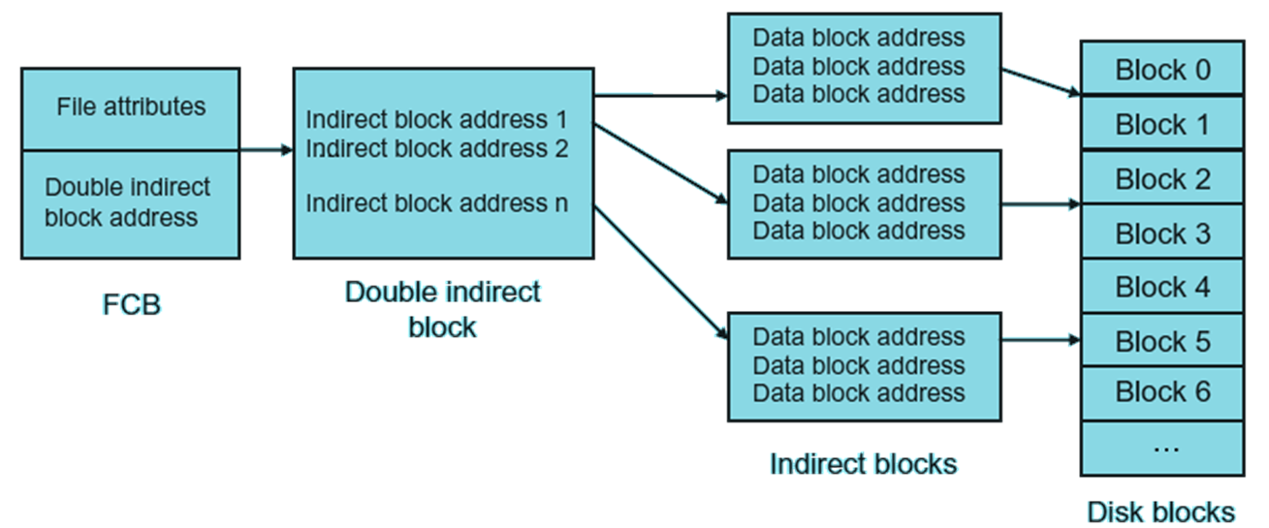
File mapping through double indirect block

Slide 8
File Allocation methods
Contiguous File Allocation
Linked/Chained File Allocation
Indexed File Allocation

Slide 9
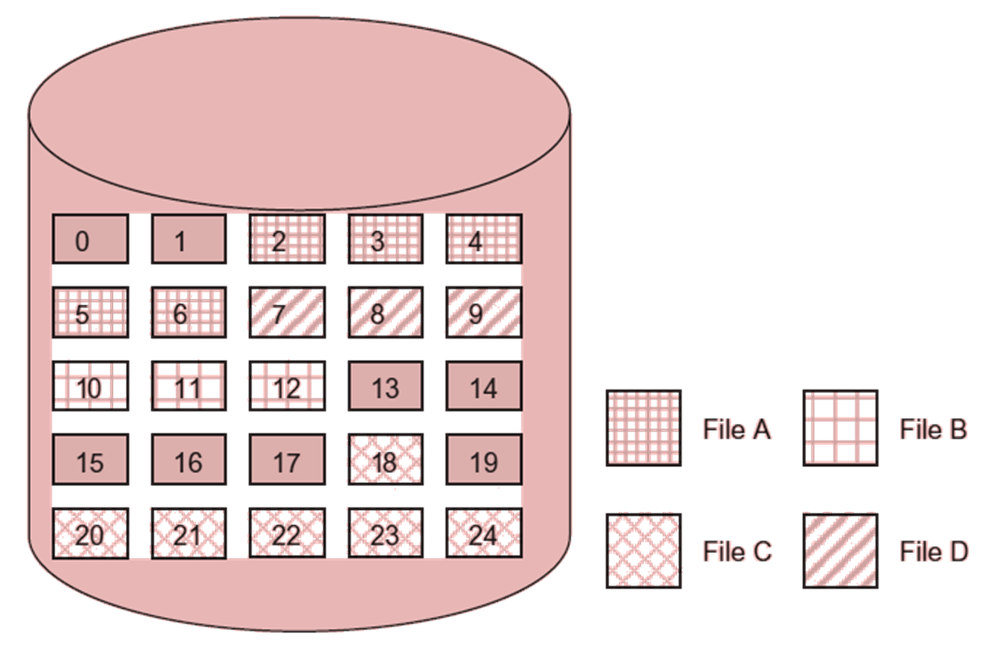
Contiguous file allocation

Slide 10
Contiguous file allocation
File name | Start address | Length
C:/project/OS/FileA | 2 | 5
C:/project/OS/FileB | 10 | 3
C:/project/OS/FileC | 18 | 7
C:/project/OS/FileD | 7 | 3

Slide 11
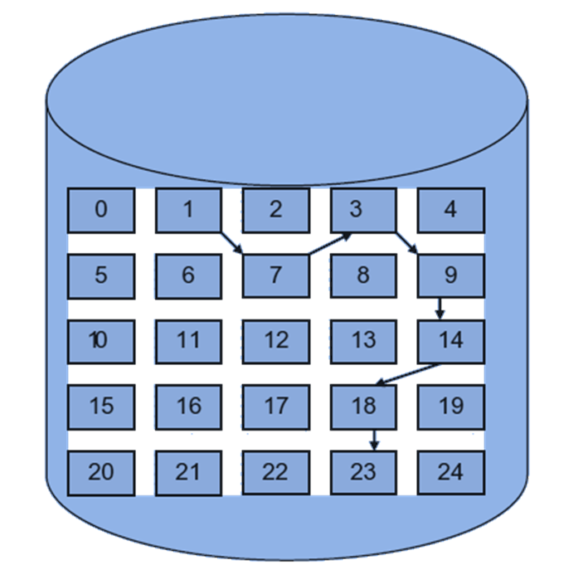
Linked file allocation

Slide 12
Linked file allocation
File name | Start address | Length
C:/project/OS/FileE | 1 | 7

Slide 13
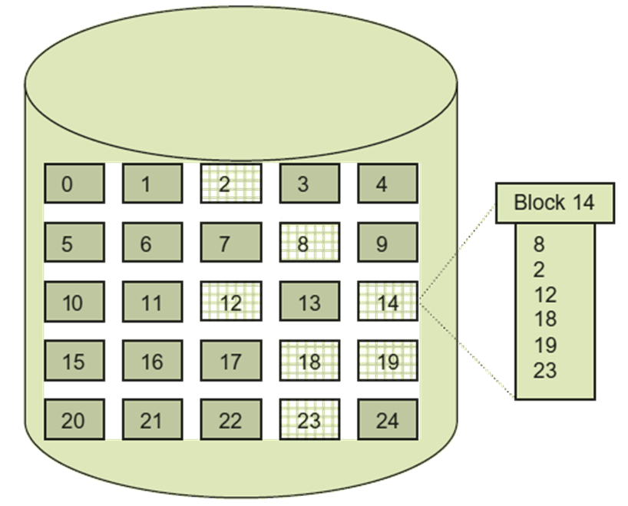
Indexed file allocation

